Slide 1
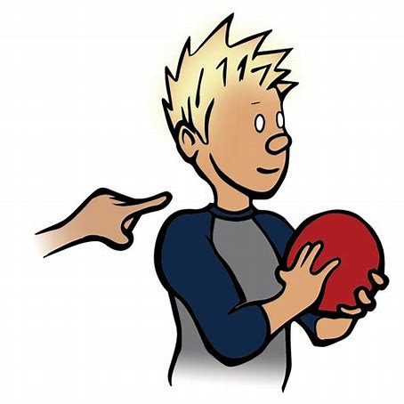

Daily Review
Reminder
Stimulus → Receptor → Control centre → Effector → Response
Describe the stimulus response model for when someone taps you on the shoulder.
Describe the stimulus response model for when you step on a sharp object on the beach.
What is the difference between these two stimulus response models?

Slide 2
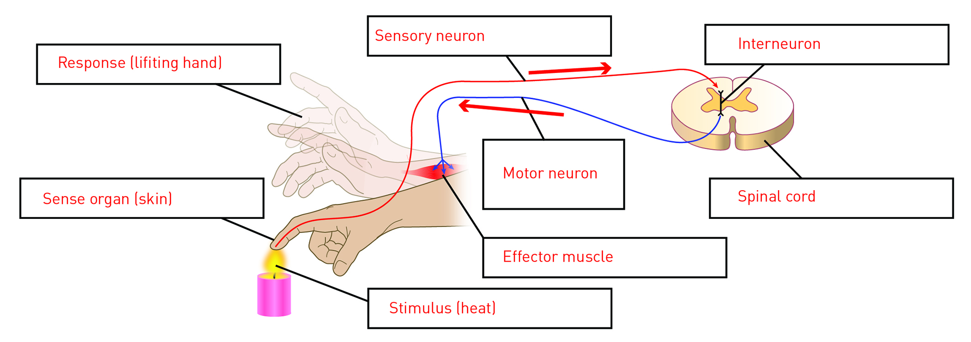
Match the following keywords with their correct place in the stimulus response model diagram.
Response
Sense Organ
Sensory Neuron
Effector
Spinal Cord
Interneuron
Stimulus
Motor Neuron
3
4
8
6
2
5
7
1

Slide 3
Neurons carry electrical messages, called nerve impulses, from one part of the body to another at very high speed.
Match the following sentences.
A Sensory Neurons | 1 carry information from the CNS to the PNS | 4 have cell body in the axon
B Interneurons | 2 carry information from the PNS to the CNS | 5 have cell body in the dendrites
C Motor neurons | 3 carry information from neuron to neuron | 6 have cell body on the axon periphery
What is a synapse?

